Slide 1
Chapter 10 Electronic Commerce Payment Systems

Slide 2
LEARNING OBJECTIVES
Understand the shifts that are occurring with regard to online payments.
Discuss the players and processes involved in using credit cards online.
Discuss the different categories and potential uses of smart cards.
Discuss various online alternatives to credit card payments and identify under what circumstances they are best used.
Describe the situations where e-micropayments are used and the alternative ways for handling these situations.
Describe the processes and parties involved in e-checking.

Slide 3
THE PAYMENT REVOLUTION
Crucial factors in determining whether a particular method of e-payment achieves critical mass:
Independence
Interoperability and Portability
Security
Anonymity
Divisibility
Ease of Use
Transaction Fees
International Support
Regulations

Slide 4
USING PAYMENT CARDS ONLINE
payment card
Electronic card that contains information that can be used for payment purposes.
Three forms of payment cards:
Credit cards
Charge cards
Debit cards

Slide 5
USING PAYMENT CARDS ONLINE
PROCESSING CARDS ONLINE
authorization
Determines whether a buyer’s card is active and whether the customer has sufficient funds.
settlement
Transferring money from the buyer’s to the merchant’s account.

Slide 6
USING PAYMENT CARDS ONLINE
Merchants use three basic configurations for processing online payments:
Own the payment software
Use a point of sale system (POS) operated by an acquirer
Use a POS operated by a payment service provider
payment service provider (PSP)
A third-party service connecting a merchant’s EC system to the appropriate acquiring bank or financial institution. PSPs must be registered with the various card associations they support.

Slide 7
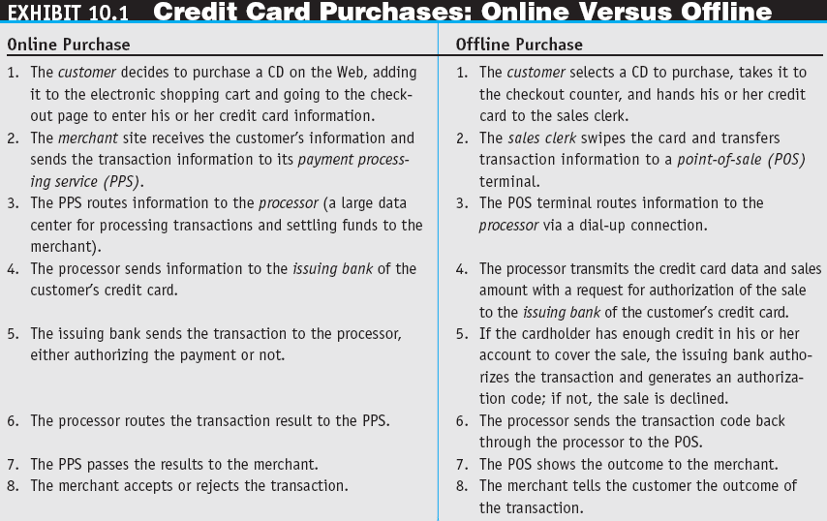

Slide 8
USING PAYMENT CARDS ONLINE
Key tools used in combating fraud:
Address Verification System (AVS)
Detects fraud by comparing the address entered on a Web page with the address information on file with the cardholder’s issuing bank.
Manual review
Fraud screens and automated decision models

Slide 9
USING PAYMENT CARDS ONLINE
card verification number (CVN)
Detects fraud by comparing the verification number printed on the signature strip on the back of the card with the information on file with the cardholder’s issuing bank.
Card association payer authentication services
Negative lists

Slide 10
SMART CARDS
smart card
An electronic card containing an embedded microchip that enables predefined operations or the addition, deletion, or manipulation of information on the card.

Slide 11
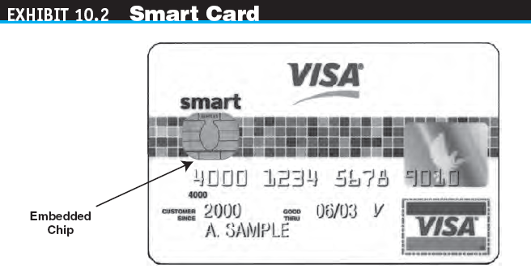

Slide 12
SMART CARDS
TYPES OF SMART CARDS
contact card
A smart card containing a small gold plate on the face that when inserted in a smart card reader makes contact and passes data to and from the embedded microchip.
contactless (proximity) card
A smart card with an embedded antenna, by means of which data and applications are passed to and from a card reader unit or other device without contact between the card and the card reader.

Slide 13
SMART CARDS
smart card reader
Activates and reads the contents of the chip on a smart card, usually passing the information on to a host system.
smart card operating system
Special system that handles file management, security, input/output (I/O), and command execution and provides an application programming interface (API) for a smart card.

Slide 14
SMART CARDS
APPLICATIONS OF SMART CARDS
Retail Purchases
Transit Fares

Slide 15
STORED-VALUE CARDS
stored-value card
A card that has monetary value loaded onto it and that is usually rechargeable.

Slide 16
E-MICROPAYMENTS
e-micropayments
Small online payments, typically under $10.
Five basic micropayment models that do not depend solely or directly on credit or debit cards:
Aggregation
Direct payment
Stored value
Subscriptions
À la carte

Slide 17
E-CHECKING
e-check
A legally valid electronic version or representation of a paper check.

Slide 18
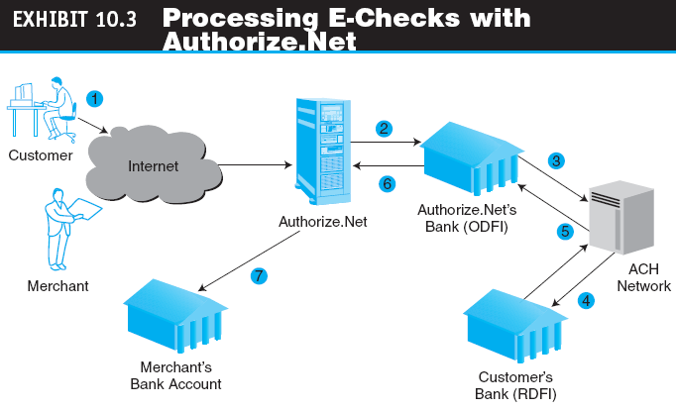

Slide 19
E-CHECKING
Automated Clearing House (ACH) Network
A nationwide batch-oriented electronic funds transfer system that provides for the interbank clearing of electronic payments for participating financial institutions.

Slide 20
MANAGERIAL ISSUES
What payment methods should your B2C site support?
What e-micropayment strategy should your e-marketplace support?
What payment methods should the C2C marketplace support?
Should we outsource our payment gateway service?
How secure are e-payments? What is the required security to use Internet banking?

Slide 21
Order Fulfillment
The following slides on Order Fulfillment are taken from Online File W10.1 available on the book’s Web site at www.pearsonhighered.com/turban

Slide 22
Order Fulfillment
Order Fulfillment and Logistics—an Overview
order fulfillment
All the activities needed to provide customers with their ordered goods and services, including related customer services.

Slide 23
Order Fulfillment
back-office operations
The activities that support fulfillment of orders, such as packing, delivery, accounting, and logistics.
front-office operations
The business processes, such as sales and advertising, that are visible to customers.

Slide 24
Order Fulfillment
logistics
The operations involved in the efficient and effective flow and storage of goods, services, and related information from point of origin to point of consumption.

Slide 25
Order Fulfillment
The EC Order Fulfillment Process
Step 1: Making sure the customer will pay
Step 2: Checking for in-stock availability
Step 3: Arranging shipments
Step 4: Insurance
Step 5: Replenishment

Slide 26
Order Fulfillment
Step 6: In-house production
Step 7: Use contractors
Step 8: Contacts with customers
Step 9: Returns
reverse logistics
The movement of returns from customers to vendors.

Slide 27
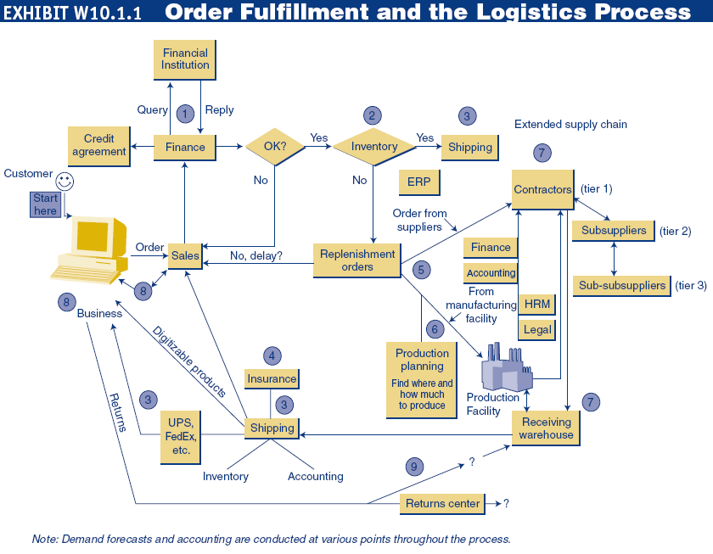

Slide 28
Order Fulfillment
Order Fulfillment and the Supply Chain
e-logistics
The logistics of EC systems, typically involving small parcels sent to many customers’ homes (in B2C). E.g. Shun Fung Express (www.sf-express.com)

Slide 29
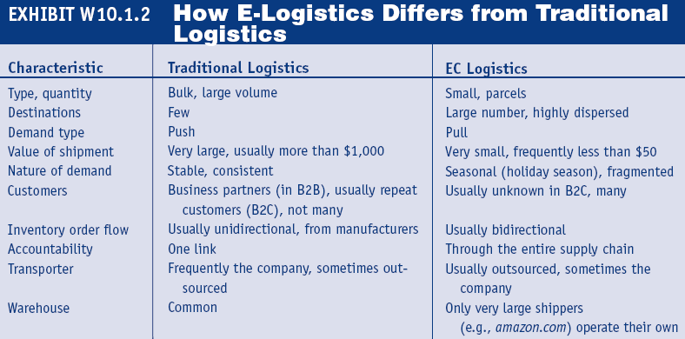

Slide 30
Addressing Problems in Order Fulfillment
Typical Supply Chain Problems
Demand forecasting is difficult
Many of the problems along the EC supply chain stem from the need to coordinate several activities, internal units, and business partners in the face of uncertainties
third-party logistics suppliers (3PL)
External, rather than in-house, providers of logistics services.

Slide 31
Addressing Problems in Order Fulfillment
Solutions to Order Fulfillment Problems
Improvements in the Order-Taking Process
Warehouse management system (WMS)
A software system that helps in managing warehouses.
Other Inventory Management Improvements
Automated Warehouses

Slide 32
Addressing Problems in Order Fulfillment
Partnering Efforts and Outsourcing Logistics
Comprehensive Logistics Services
Speeding Deliveries
Handling Returns (Reverse Logistics)
Return the item to the place of purchase
Separate the logistics of returns from the logistics of delivery
Completely outsource returns
Allow the customer to physically drop the returned item at a collection station
Auction the returned items

Slide 33
Addressing Problems in Order Fulfillment
Order Fulfillment in B2B
Using BPM to Improve Order Fulfillment

Slide 34
